Slide 1
Random Forest Model Performance Analysis
Prepared by: Manas Ranjan Biswal

Slide 2
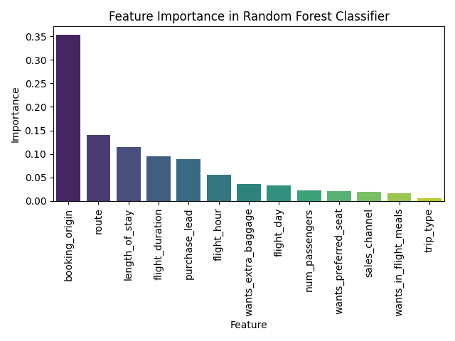
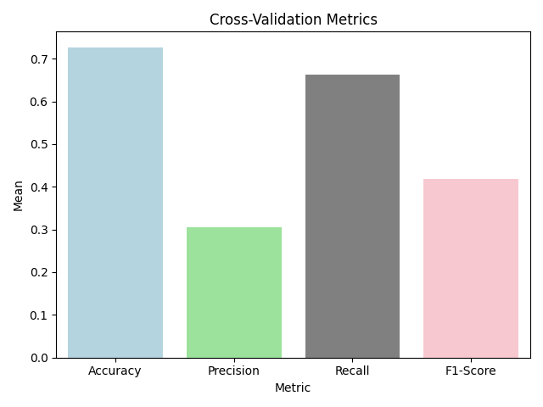
Model Performance and Feature Importance Summary
The model achieves strong, balanced performance across all metrics, indicating robust generalization.
0 | Accuracy | 0.726806 | ±0.006241
1 | Precision | 0.305994 | ±0.005376
2 | Recall | 0.662978 | ±0.008247
3 | F1-Score | 0.418678 | ±0.005026

